Slide 1

Alfresco Zimbra Integration
Yong Qu
Direct of Solutions Engineering
www.alfresco.com

Slide 2
Introduction
Integration of two leading open source solutions
  Alfresco Enterprise Content Management
  Zimbra Collaboration Suite
Built on top of open technologies
  Zimbra Zimlet
  Alfresco Webscript
  YUI Library

Slide 3
Key Features
Allowing end user to save incoming email attachments to Alfresco ECM Server.
Allowing end user to select multiple Alfresco documents and attach them to outgoing emails.
Providing links for downloading Alfresco Documents when composing emails.
Allowing end user to paste short links to Alfresco documents directly into outgoing email body.
Providing easy-to-use widgets for Alfresco space selection and repository navigation.
Simple installation and setup.
Notes:
24/07/06

Slide 4


Architecture
Zimlet
Webscripts
Attachment Handler
Security Service
Attachment Dialog
JSON/XML/HTML
Over HTTP
Document Service
YUI Library
Query Service
User Preferences

Slide 5
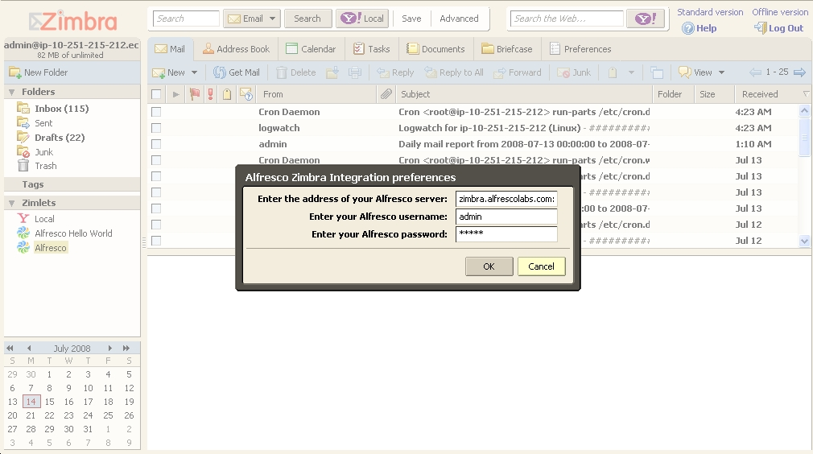
Alfresco Zimlet in Action

Slide 6
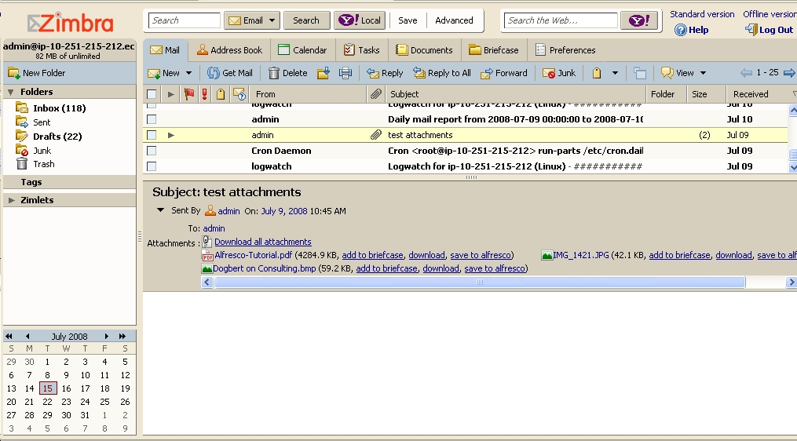
Alfresco Zimlet in Action

Slide 7
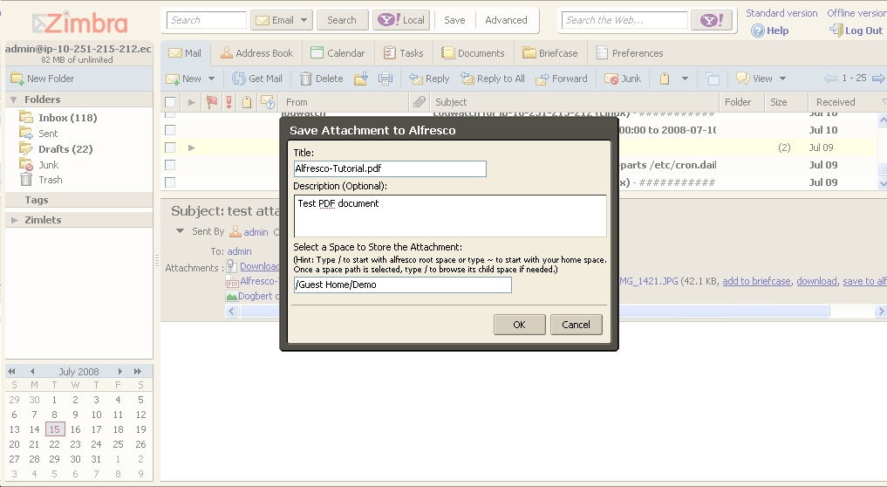
Alfresco Zimlet in Action

Slide 8
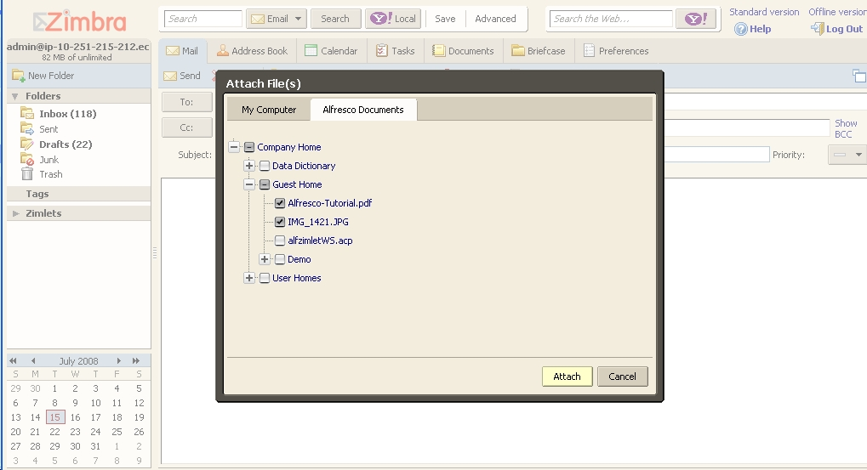
Alfresco Zimlet in Action

Slide 9
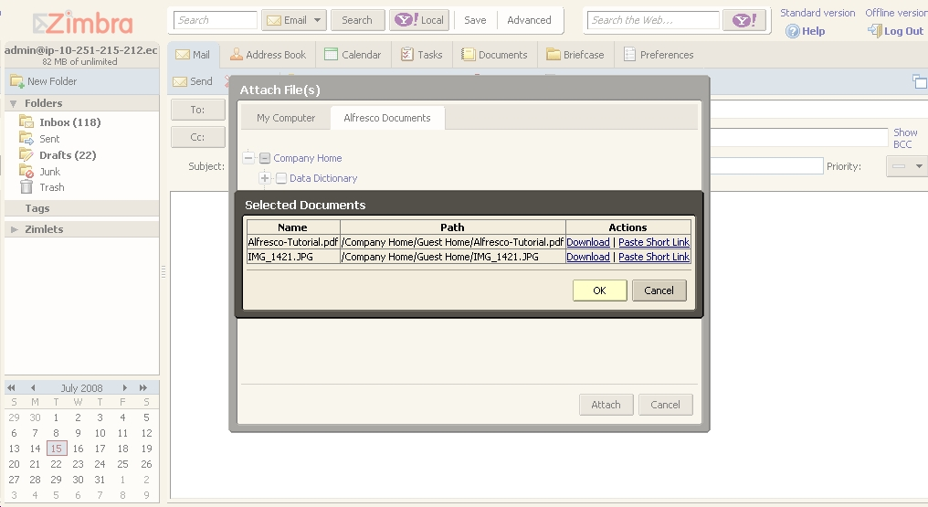
Alfresco Zimlet in Action

Slide 10
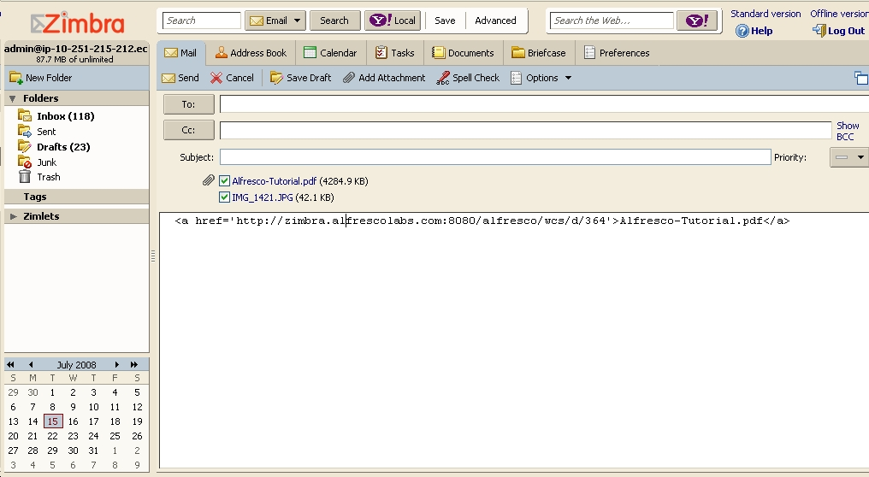
Alfresco Zimlet in Action

